Slide 1
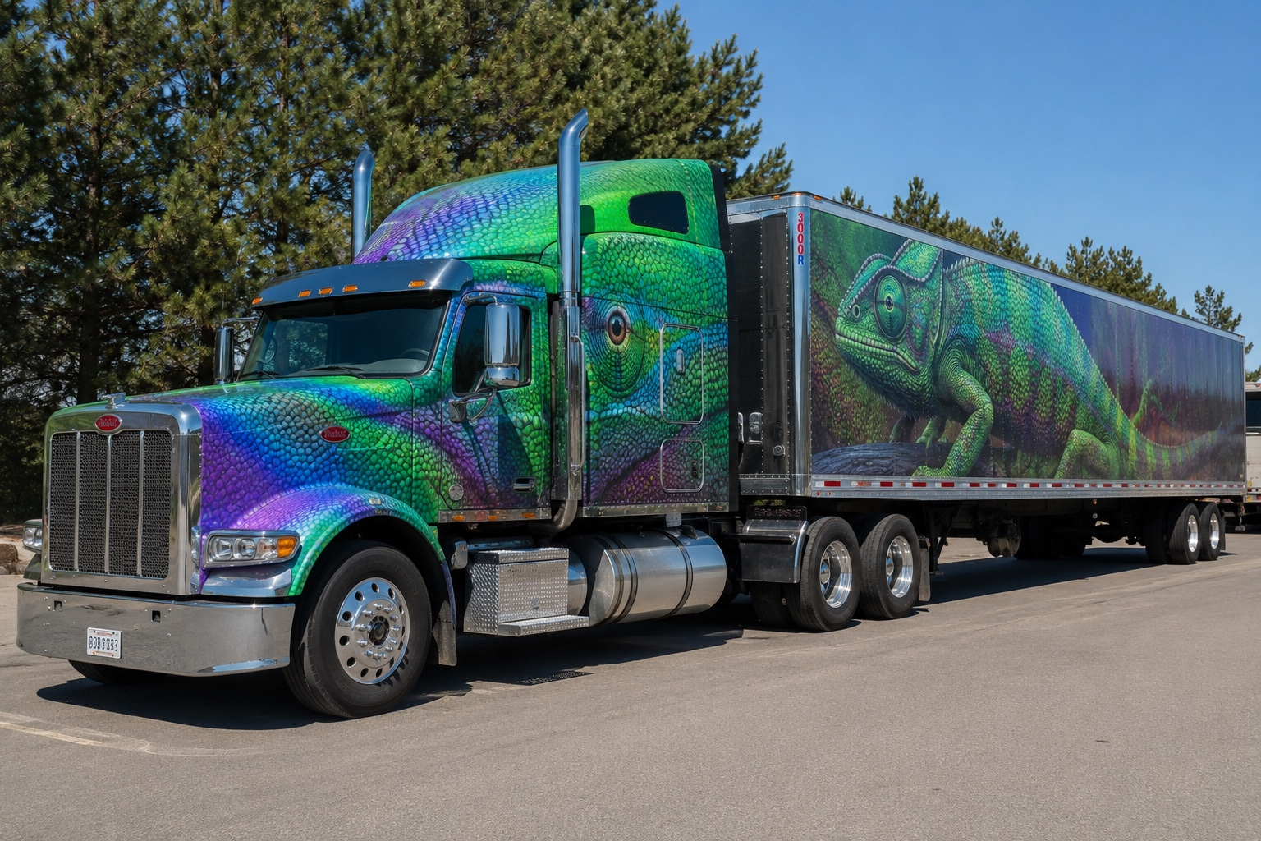
Broker vs. Carrier, Chameleon Carriers
What CAB, FMCSA, underwriters, and plaintiff attorneys see when the dots start connecting.
Kerra Grantski | Transportation Vertical Leader | Holmes Murphy
Notes:
Good morning. I am Kerra Grantski, and I lead the transportation vertical at Holmes Murphy, which is an insurance agency.,I promise this is not going to be forty-five minutes of insurance definitions. Nobody deserves that before lunch, after lunch, or frankly ever.,Today we are talking about chameleon carriers: what they are, what they are not, why they matter, and why this issue is getting attention from FMCSA, underwriters, brokers, carriers, and plaintiff attorneys.,My goal is simple. When you leave, I want you to understand how these connections show up, what they mean, and what they do not mean.

Slide 2
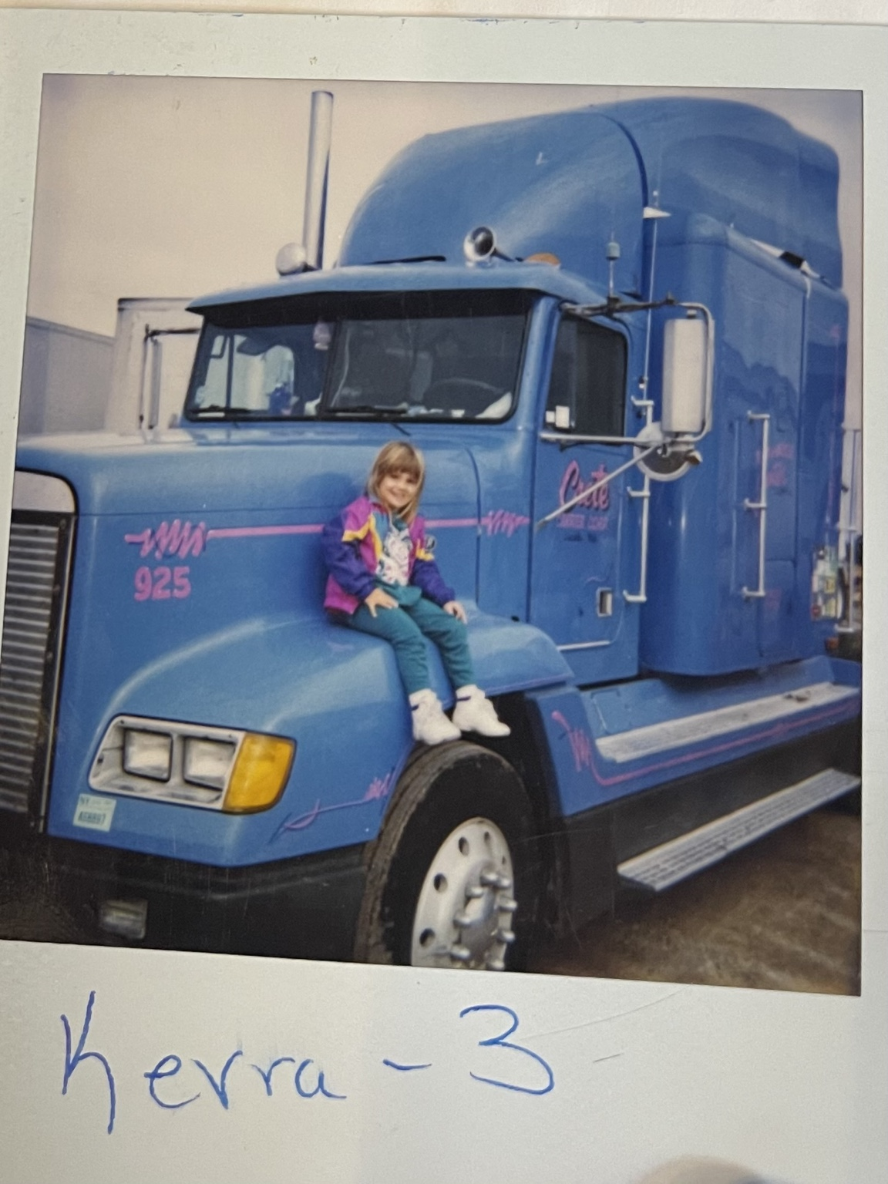
Trucking is in my blood.
Why I Care About This
Great-grandpa owned a trucking company.
Grandpa had his own authority.
Dad was an owner-operator from the time I was born.
When I was five, my parents started their own trucking company - and they still have a fleet today.
I spent many summers and weekends in a truck or at the shop
I grew up in trucking before I ever sold insurance to trucking.
Notes:
Before I get into CAB reports and federal rules, I want you to know why I care about this industry.,Trucking is not just a vertical to me. It is my family.,My great-grandpa owned a trucking company. My grandpa had his own authority. My dad was an owner-operator for Crete Carrier from the time I was born.,When I was five, my parents started their own trucking company, and they still have a fleet today.,So I did not learn trucking from a marketing brochure. I learned it from being around trucks, drivers, dispatch, shops, customers, and all the beautiful chaos that comes with this business.,The best thing in the world for me now is that I get to sell insurance to my kind of people.

Slide 3
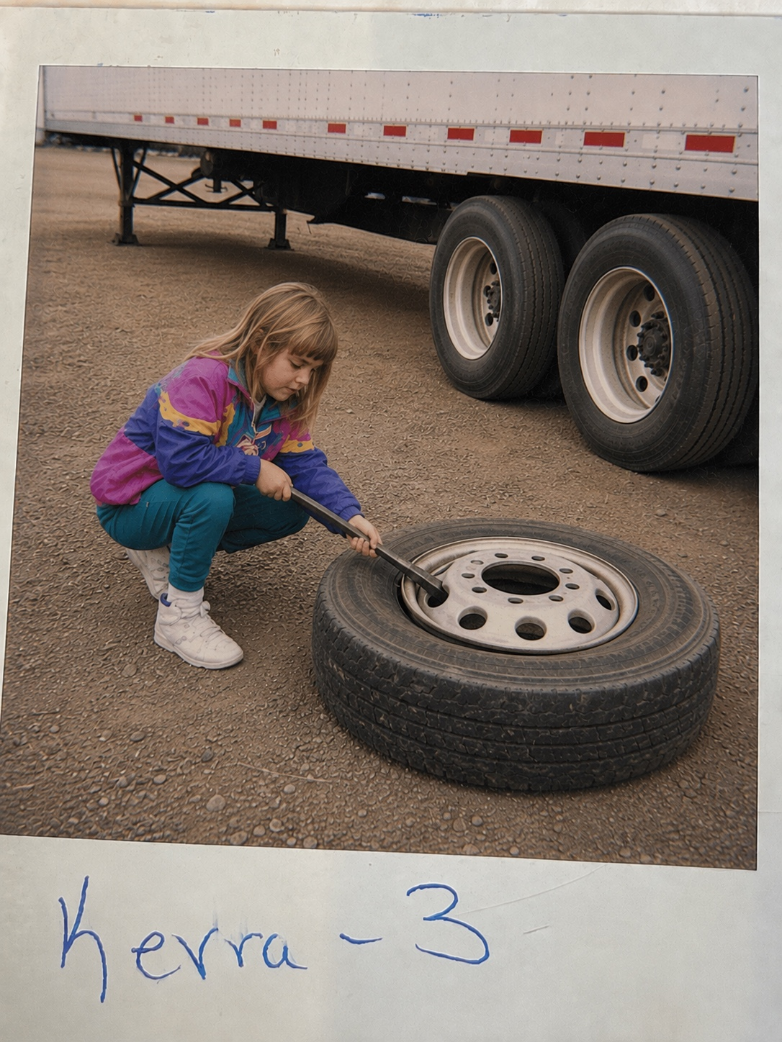
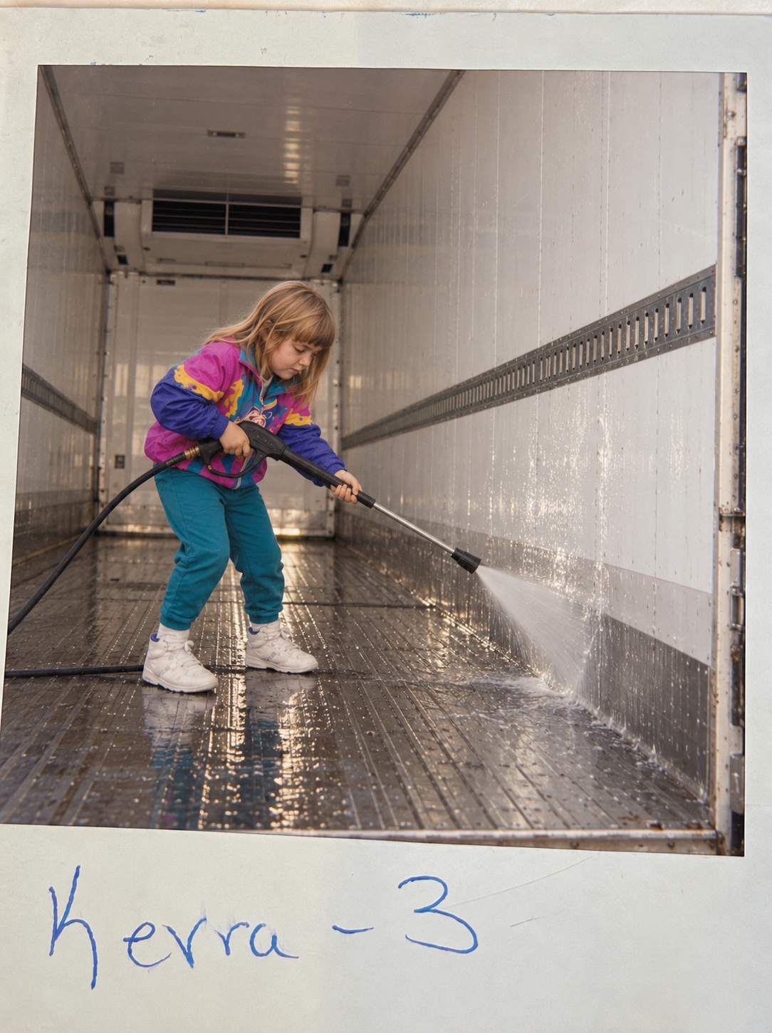
I know HARD work
Breaking down tires
Washing out a trailer that just got done hauling combos of fresh pet-food ingredients. You all know exactly what those trailers look like.
Eventually I graduated to the office CALLING shippers and receivers to schedule pickups and deliveries.
Notes:
And like a lot of trucking kids, I had what I will call character-building jobs.,Breaking down tires. Washing out combos full of fresh pet-food ingredients.,And you all know exactly what those trailers look like. More importantly, you know what they smell like.,But I got fifty bucks for that. And when you are a kid, fifty bucks is basically private-equity money.,Now obviously these two pictures are AI-generated. I definitely broke down tires and washed out trailers, but clearly not at the age of three. Probably closer to eight or ten.,My parents did not take pictures of that. I am assuming that had something to do with child labor laws.

Slide 4
What is a Chameleon Carrier
What “chameleon” really means - and what it does not mean.
What We Can See
How it shows up in CAB and what the breadcrumbs look like.
Translate it to Insurance
Why underwriters care and why structures create exposure.
Contract and Broker Authority
What is the proper structure and why is it necessary.

Slide 5
So… is this a chameleon carrier?
Notes:
So, when I say chameleon carrier, is this what I mean?,No.,But I will give it credit. This truck understood the assignment.,This is a chameleon-looking carrier, not a chameleon carrier.

Slide 6
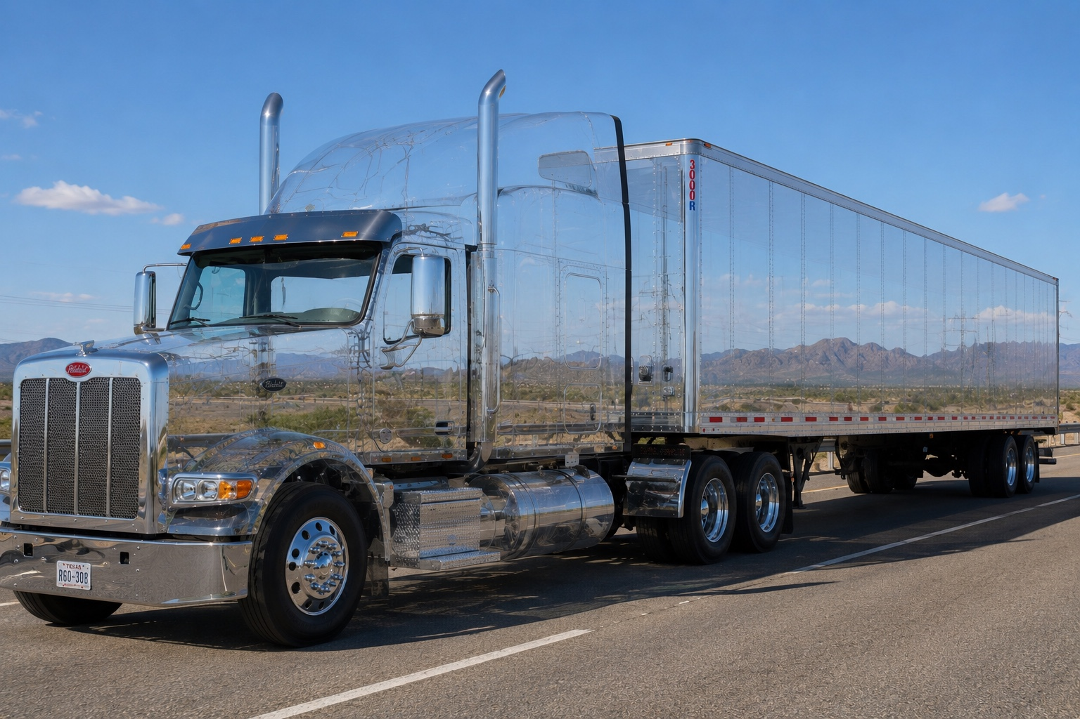
Is it this?
No - but some of you wish you had a button to do this to your truck and trailer while going past a scale.
Notes:
Is it this?,Also no.,But I am willing to bet there are at least a couple people in this room who wish their truck could flip a switch, blend into the surroundings, and coast right past a scale.,For the record, Holmes Murphy does not endorse that as a risk-management strategy.

Slide 7
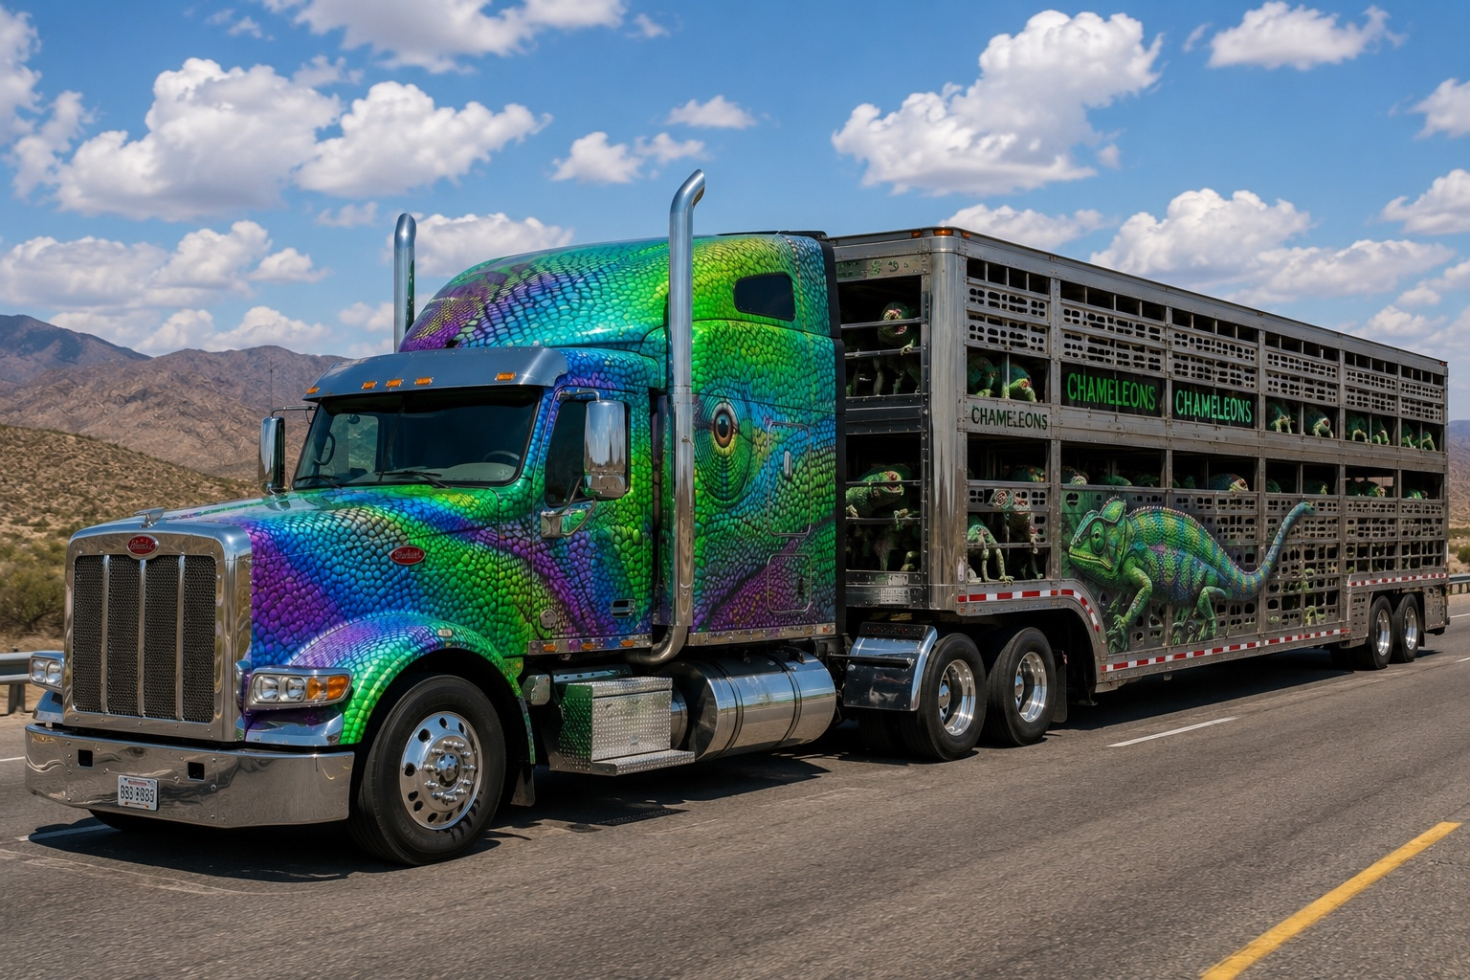
What about a truck hauling chameleons?
Still no, but interesting.
Notes:
What about this one? A truck hauling a load of chameleons?,Also not it.,But I figured if we are going to talk about federal compliance and insurance exposure for forty-five minutes, the least I can do is give you a few ridiculous pictures first.,Okay. I am done with AI for a little while. Let's get into what this actually means.

Slide 8
What It Actually Means
A chameleon/reincarnated carrier issue is not just “two companies know each other.”
The core concern is an operation that disappears and reappears - or operates through an affiliated entity - to avoid a safety record, enforcement action, penalties, insurance consequences, or scrutiny.
Breadcrumbs: shared ownership, address, phone, equipment, or employees.
They are not automatically proof of wrongdoing by themselves.
They are things that make the FMCSA, CAB, Underwriters or a plaintiff attorney start asking more questions
Notes:
Here is the accurate definition, and this distinction matters.,A chameleon carrier issue is not simply two companies knowing each other, sharing a customer, or even having common ownership.,The core concern is an operation that disappears and reappears, or operates through an affiliated entity, to avoid a safety record, an enforcement action, penalties, insurance consequences, or scrutiny.,So when we see common ownership, shared address, shared phone number, shared equipment, shared employees, or overlapping representatives, those are breadcrumbs.,They are not automatic proof by themselves. They are the things that make FMCSA, CAB, an underwriter, or a plaintiff attorney start asking more questions.,Sources for this concept include FMCSA's reincarnated-carrier rules at 49 CFR 386.73 and FMCSA's chameleon carrier methodology report.

Slide 9
Why This Is Getting Attention?
Safety History
Insurance Integrity
A new name should not erase a bad operating history.
Applications, prior losses, authority, ownership, and exposure have to match reality.
Litigation
Market Fairness
When the loss is catastrophic, every connected entity can become part of the story.
Legitimate carriers compete against operators that may be dodging accountability.
Notes:
Why does this matter? Because a new name should not erase a bad operating history.,From an insurance standpoint, the problem is integrity of information. Underwriters make decisions based on who owns the operation, who controls it, what equipment is being used, what authority is active, what losses belong to the risk, and what exposures are actually being presented.,From a litigation standpoint, when the loss is catastrophic, nobody looks at one clean little box. Plaintiff attorneys look at the whole operation and ask who had money, who had control, who hired whom, and who benefited from the load.,And from a market standpoint, legitimate carriers should not have to compete against companies that can simply change names and avoid consequences.

Slide 10
FMCSA already has tools for this.
49 CFR § 386.73
FMCSA may determine whether a motor carrier, broker, freight forwarder, or intermodal equipment provider is reincarnated or affiliated based on substantial continuity/common ownership or control.
Reincarnated
“Merely a continuation” of another entity.
Affiliated
Business operations under common ownership and/or common control.
Potential actions
Out-of-service orders and record-consolidation orders.
Notes:
FMCSA already has tools for this.,Under 49 CFR section 386.73, FMCSA can look at whether there is substantial continuity between entities. In plain English: is this new company really just the old company wearing a new jacket?,The regulation also addresses affiliated entities when business operations are under common ownership or common control.,The possible consequences can include out-of-service orders or record-consolidation orders.,This matters for today's conversation because the same things FMCSA looks at are the same things that show up in the reports we all use: ownership, management, addresses, phone numbers, equipment, drivers, and operating patterns.

Slide 11
2026 Current Event: The REVOKE Act
In September 2026 ATA backed legislation aimed at stopping carriers from operating under inactive USDOT numbers and strengthening enforcement against chameleon carriers.
This is no longer just a back-office underwriting issue. It is a compliance, registration, enforcement, insurance, and claims issue - and the industry is pushing for tighter rules.

Slide 12
Anybody here ever looked at your own CAB report?
CAB is basically your best friend’s diary about you.
It knows the good, the bad, the ugly - and every once in a while, it knows something about you that you did not even know about yourself.
Notes:
Now let's talk about this from the insurance side.,Anybody in here ever looked at your own CAB report?,CAB is basically your best friend's diary about you.,It knows the good, the bad, the ugly, and every once in a while it knows something about you that you did not even know about yourself.,And for anyone who has ever sat across from an underwriter, you already know: if it is in CAB, they probably saw it before they read the application.

Slide 13
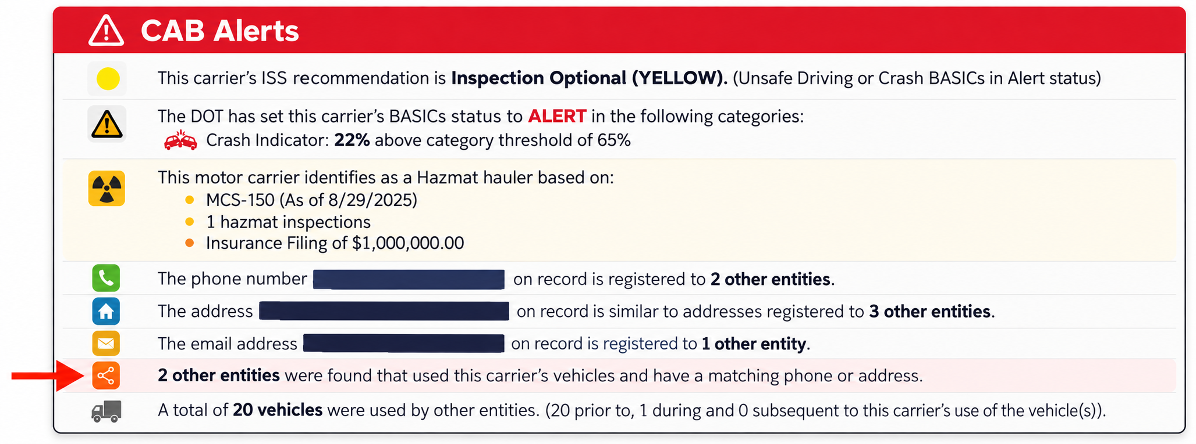

CAB Alerts
Notes:
Now I wish this was AI.,It is absolutely not.,This is an actual CAB report. See that little chameleon icon? That is CAB telling us it found potential relationships between this carrier and other entities.,Look at the language. Phone number tied to other entities. Address similar to other entities. Email address registered to another entity. Vehicles that were used by other entities.,That does not mean we immediately yell fraud. It means we stop looking at one DOT number in isolation and start asking: what is the full picture here?

Slide 14
The Breadcrumbs CAB and Underwriters Notice
Common ownership
Common officers/managers
Shared employees
Shared address or business location
Shared phone/email/contact person
Shared equipment/vehicles
These are indicators but not automatic proof.
Notes:
These are the breadcrumbs.,Common ownership. Common officers, directors, managers, or representatives. Shared employees. Shared addresses or business locations. Shared phone numbers, email addresses, or contact information. Shared equipment or vehicles.,Again, these are indicators. They are not automatic proof by themselves.,But when several of them line up, it starts to look less like coincidence and more like a connected operation.,And that is where underwriters start getting uncomfortable, because underwriting is about pricing and accepting the actual exposure, not the cleanest version of the exposure.

Slide 15
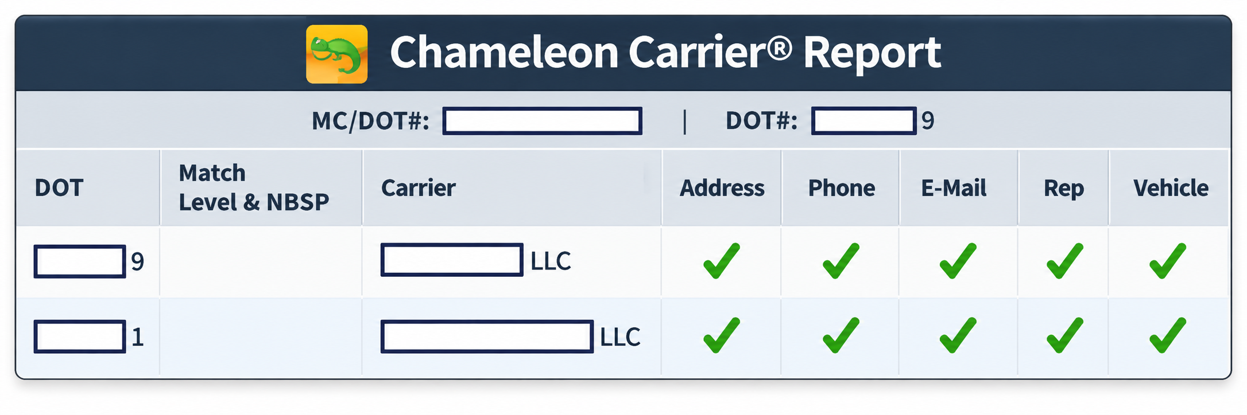
CAB Does Not Just Flag It. It Maps It.
This is where the report shows the related entities and exactly what is matching: address, phone, email, representative, vehicles.
Kerra Grantski | Holmes Murphy | Missouri Trucking Association
Notes:
This next snapshot is important because CAB does not just give you a cute little chameleon and walk away.,It actually maps the entities and shows what is matching.,Address. Phone. Email. Representative. Vehicle.,This is where the conversation changes from, 'This carrier looks fine,' to 'Let's look at the network around this carrier.',That is exactly how underwriters, claims people, safety people, and attorneys think about it.

Slide 16
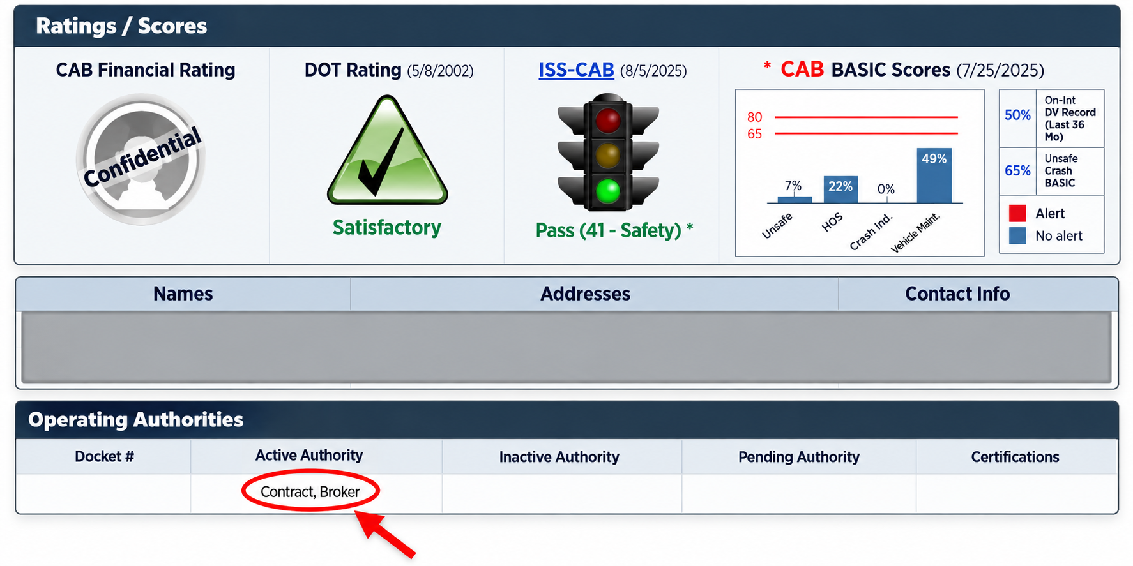
Red Flag Does Not Always Mean Chameleon
A carrier can have motor-carrier authority and broker authority. That is not automatically wrong — but it absolutely changes the questions.
Are you operating both a Contract & Broker Authority under the same DOT number?
Do you have a separate brokerage set up with its own DOT# but the same information “breadcrumbs” as your primary trucking company?
Notes:
This is another important distinction.,A company can have motor-carrier authority and broker authority. That is not automatically a chameleon carrier. It is not automatically wrong.,But it absolutely changes the questions.,If you operate as a carrier and a broker, I need to understand how the operations are separated, how loads are assigned, who is hauling what, what insurance applies, and whether the exposure was actually presented to the carrier and the insurance company.,A lot of transportation underwriters get nervous here because the broker exposure is not always the exposure they intended to pick up on a motor-carrier auto policy.

Slide 17
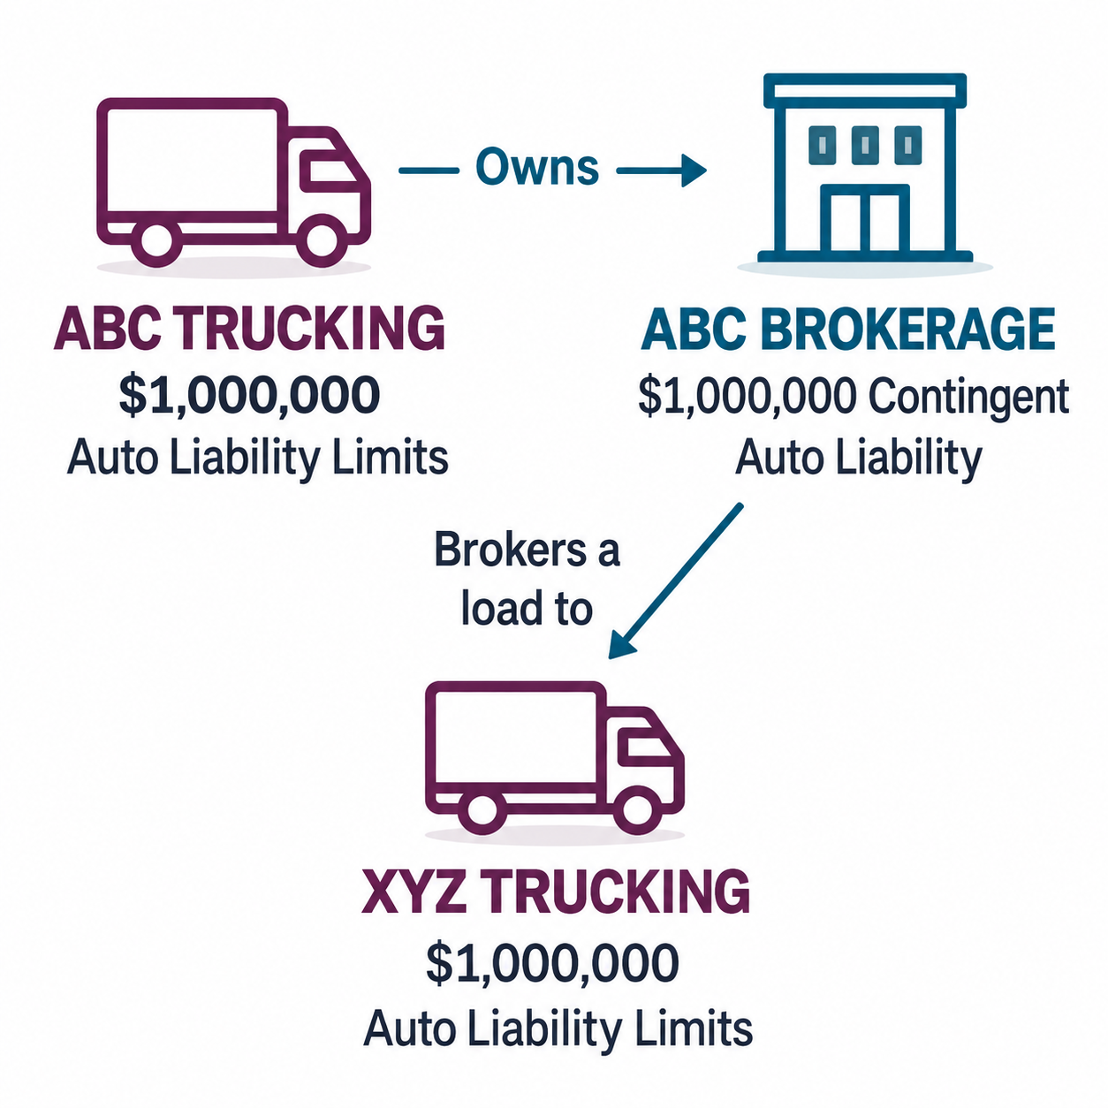

Why This Structure Makes Underwriters Twitch
Claims Example:
ABC Trucking owns ABC Brokerage.
ABC Brokerage gives a load to XYZ Trucking.
XYZ hands over a certificate that looks legitimate.
Then a catastrophic accident happens.
Now attorneys are following the breadcrumbs.
Notes:
This diagram is a simple version of why underwriters twitch when they see carrier and broker operations tied together.,ABC Trucking owns ABC Brokerage.,ABC Brokerage brokers a load to XYZ Trucking.,XYZ gives ABC Brokerage a certificate of insurance. It looks legitimate.,But what if the policy canceled? What if the certificate is inaccurate? What if the carrier was not actually insured the way everyone thought? What if the authority is questionable?,XYZ takes the load, crosses the center line, and causes a serious bodily-injury loss.,Now the plaintiff attorney is not just looking at XYZ. They are looking at everyone connected to the load, everyone who had control, everyone who benefited, and everyone with insurance.

Slide 18
Three Different Issues Get Mixed Together
1
You are now being named in a lawsuit.
2
If the two businesses are intertwined, it gives the plaintiff attorney more to work with.
3
How insurance responds and pays?
Policy wording, facts, exclusions, and triggers matter.
Duty to defend and duty to pay are not the same thing.
Notes:
This is the part I want everyone to remember, because it is where insurance conversations get messy.,Being named in a lawsuit, being legally liable, having insurance respond, and actually having indemnity paid are four different issues.,If a broker-related claim happens and your motor-carrier entity is connected to that broker, it does not mean ABC Trucking automatically owes the claim.,But it may mean ABC Trucking gets named, defended, deposed, and dragged through the process.,And when you hear 'we have contingent auto liability,' remember that contingent auto is not the same thing as a primary auto policy for every truck a broker hires. The wording, trigger, exclusions, underlying coverage, and facts all matter.

Slide 19
The Supreme Court made this more real in 2026.
Montgomery v. Caribe Transport II, LLC
What happened:
Sean Montgomery was stopped on the shoulder of an Illinois highway when a tractor-trailer driven by Yosniel Varela-Mojena struck his truck.
Montgomery suffered catastrophic injuries including the amputation of his leg.
Varela-Mojena was hauling for Caribe Transport II, LLC and C.H. Robinson had brokered the load.
Montgomery alleged that C.H. Robinson negligently selected Caribe because Caribe allegedly had a “conditional” FMCSA safety rating and deficiencies involving driver qualification, hours of service, vehicle inspection/maintenance, crash rate, and other safety areas.
Notes:
And if you think I am just an insurance agent trying to scare you into buying more coverage, this issue went all the way to the United States Supreme Court this year.,In Montgomery v. Caribe Transport II, the Supreme Court held that a state-law negligent-hiring or negligent-selection claim against a freight broker was not preempted by the FAAAA when the claim concerned motor-vehicle safety.,Now, be careful with what that means.,The Supreme Court did not say the broker was negligent. It did not say the broker was liable. It did not say every broker loses every case.,It said the broker does not automatically get out of that kind of claim just because it is a broker.,That is a huge difference, and it matters for how broker-carrier relationships get viewed after a catastrophic loss.

Slide 20
The Supreme Court made this more real in 2026.
Montgomery v. Caribe Transport II, LLC
The Court held that a state-law negligent-hiring/negligent-selection claim against a freight broker was not preempted by the FAAAA when the claim concerned motor-vehicle safety.
Important:
The Supreme Court did not say the broker was negligent.
It did not say the broker was liable.
It did not say every broker loses every case.
IT SAID the broker does not automatically get out of that kind of claim just because it is a broker.
That is a HUGE difference, and it matters how broker-carrier relations get viewed after a catastrophic loss.
Notes:
And if you think I am just an insurance agent trying to scare you into buying more coverage, this issue went all the way to the United States Supreme Court this year.,In Montgomery v. Caribe Transport II, the Supreme Court held that a state-law negligent-hiring or negligent-selection claim against a freight broker was not preempted by the FAAAA when the claim concerned motor-vehicle safety.,Now, be careful with what that means.,The Supreme Court did not say the broker was negligent. It did not say the broker was liable. It did not say every broker loses every case.,It said the broker does not automatically get out of that kind of claim just because it is a broker.,That is a huge difference, and it matters for how broker-carrier relationships get viewed after a catastrophic loss.

Slide 21
What underwriters & attorneys are really asking
?
Who owns and controls each entity?
?
Are the operations truly separate?
?
Which DOT number is moving the load?
?
Which policy was intended to cover which exposure?
?
Are the applications, CAB report, contracts, and certificates telling the same story?
Notes:
This is what underwriters are really asking.,Who owns and controls each entity?,Are the operations truly separate?,Which DOT number is moving the load?,Which policy was intended to cover which exposure?,And maybe most importantly: are the applications, CAB report, contracts, certificates, and real-world operations all telling the same story?,Underwriters can handle complicated. What they hate is surprise.

Slide 22
Practical Takeaways
Do not assume a separate entity means separate exposure.
1
If you have carrier and broker operations, document the separation intentionally.
2
Make sure certificates, contracts, DOT records, and insurance applications match reality.
3
Tell the story before someone else tells it for you.
4
Notes:
Here are the practical takeaways.,Do not assume a separate entity means separate exposure.,Review CAB before the underwriter, claim adjuster, or plaintiff attorney does.,If you have carrier and broker operations, document the separation intentionally.,Make sure certificates, contracts, DOT records, and insurance applications match reality.,And finally, tell the story before someone else tells it for you.,If there is a legitimate reason for the structure, say that. If operations are separate, document that. If something changed, explain it before a claim forces everyone to reverse-engineer it.

Slide 23
This is not about making good carriers look bad.
It is about making sure the name on the door, the DOT record, the CAB report, the insurance policy, and the actual operation all tell the same story.
Because after a bad claim, everyone is going to read that story.
Notes:
I want to be clear: this is not about making good carriers look bad.,Most people in this room are doing the best they can in a hard business with changing rules, rising costs, tight freight, tough insurance markets, and a lot of moving parts.,This is about making sure the name on the door, the DOT record, the CAB report, the insurance policy, and the actual operation all tell the same story.,Because after a bad claim, everyone is going to read that story.,The question is whether you wrote it on purpose, or whether someone else writes it for you after the fact.

Slide 24
Missouri Trucking Association, thank you for having me.
I am Kerra Grantski with Holmes Murphy. I also want to introduce Devin Gragg, my counterpart, and Elizabeth Lowrey from our Risk & Safety team.
We will be around tonight if anyone wants to talk through questions, CAB reports, broker exposure, or just swap trucking stories.

